Slide 1

IoT based Weather Monitoring System
Experiment 3:
Navarro, Rod Geryk C.
CPE162P- 4 - E01

Slide 2
OBJECTIVES
1. To demonstrate how an IoT-based weather monitoring system works: - The goal is to show how weather data such as temperature and humidity can be automatically measured using sensors connected to an embedded system. This data will be transmitted over the internet, allowing real-time monitoring from any location.
2. To apply knowledge learned in Logic Circuits and Switching Theory, Microprocessors, CPE160P, and CPE161P courses: - This project will serve as a hands-on application of the concepts and skills learned from various computer engineering subjects.
3. To apply embedded systems with IoT using an Arduino kit: - The project will use an ESP32 Dev Module as the core of the embedded system. The Module collects data from weather sensors (LM35 for temperature and DHT11 for humidity), processes that data, and connects to the internet. This combination of hardware and internet connectivity creates a practical IoT system.
4. To use ThingSpeak for data collection, monitoring, and analysis: - ThingSpeak, a cloud-based platform, will be used to collect sensor data, visualize it through graphs, and analyze trends over time.

Slide 3
MATERIALS
Arduino Kit
Laptop
ESP32 Dev Module - x1
LCD – x1
LM35 Sensor – x1
DHT11 Sensor – x1

Slide 4
INTRODUCTION
This project aims to demonstrate how an IoT-based weather monitoring system works by automatically collecting temperature and humidity data using sensors connected to an ESP32 Dev Module. The data is sent to the internet for real-time monitoring using ThingSpeak, a cloud platform for data collection and analysis. The project applies lessons from computer engineering courses like Logic Circuits, Microprocessors, CPE160P, and CPE161P. It also shows how embedded systems and IoT can work together using simple components like the LM35 and DHT11 sensors.

Slide 5
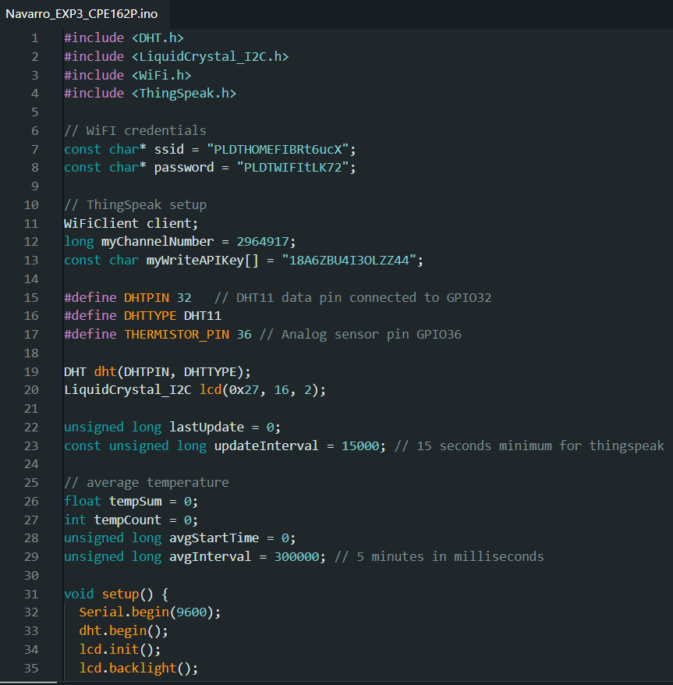
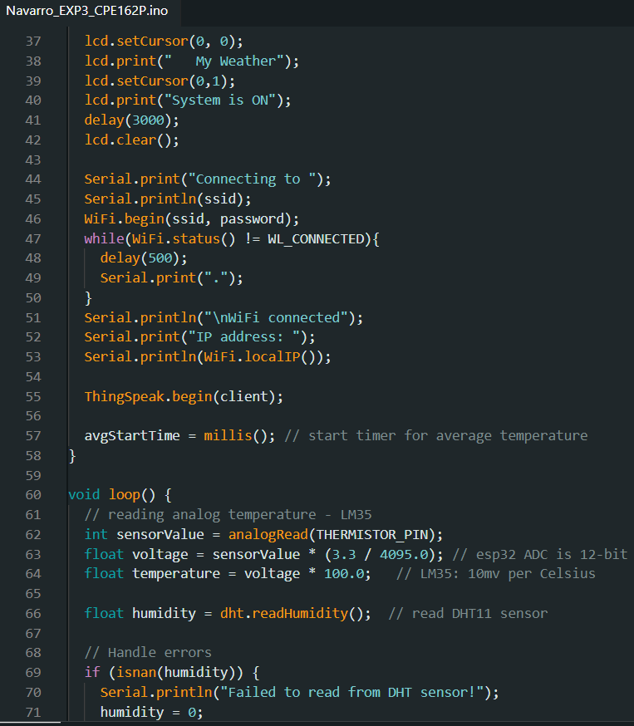
SOFTWARE DISCUSSION

Slide 6
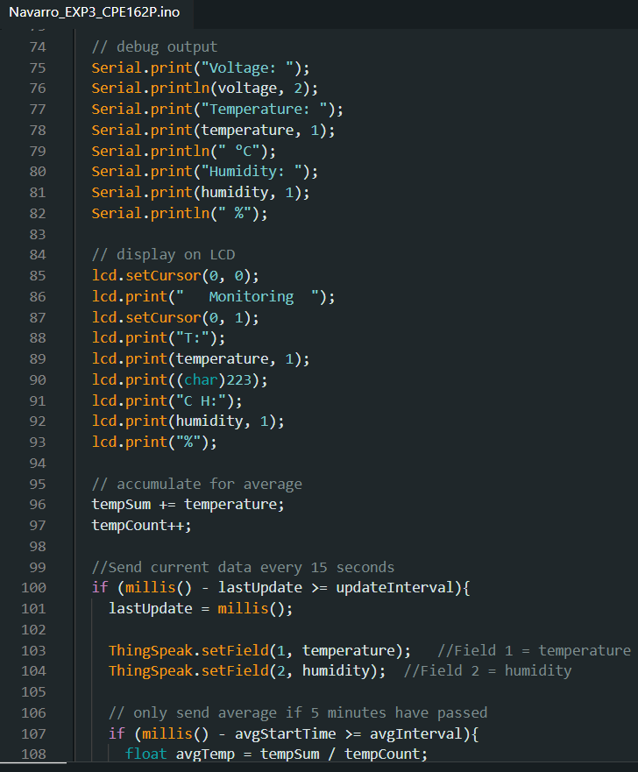
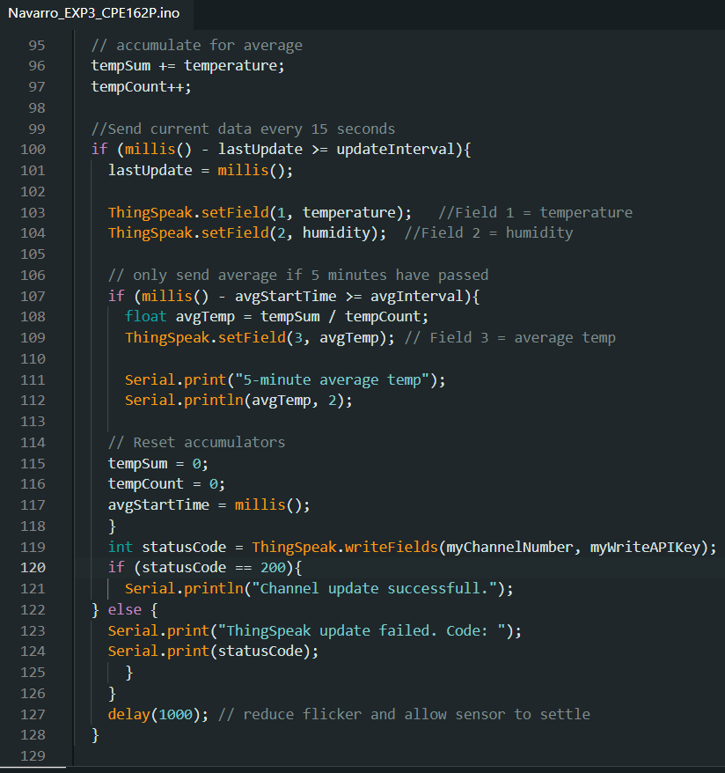
SOFTWARE DISCUSSION

Slide 7
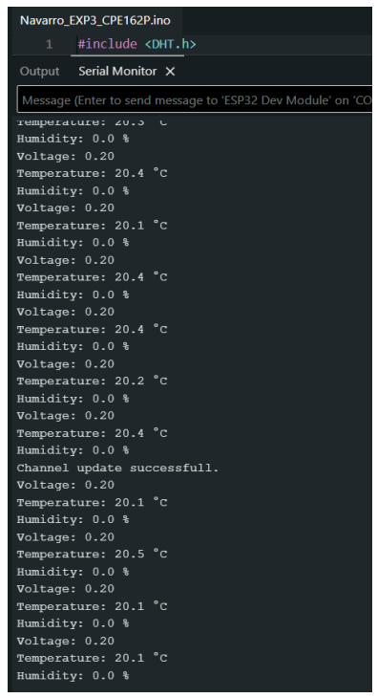
SOFTWARE DISCUSSION

Slide 8
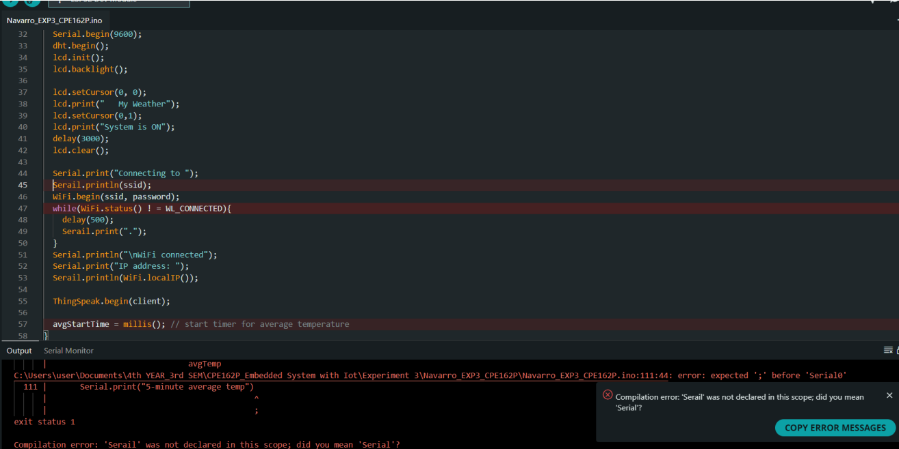
SOFTWARE DISCUSSION

Slide 9
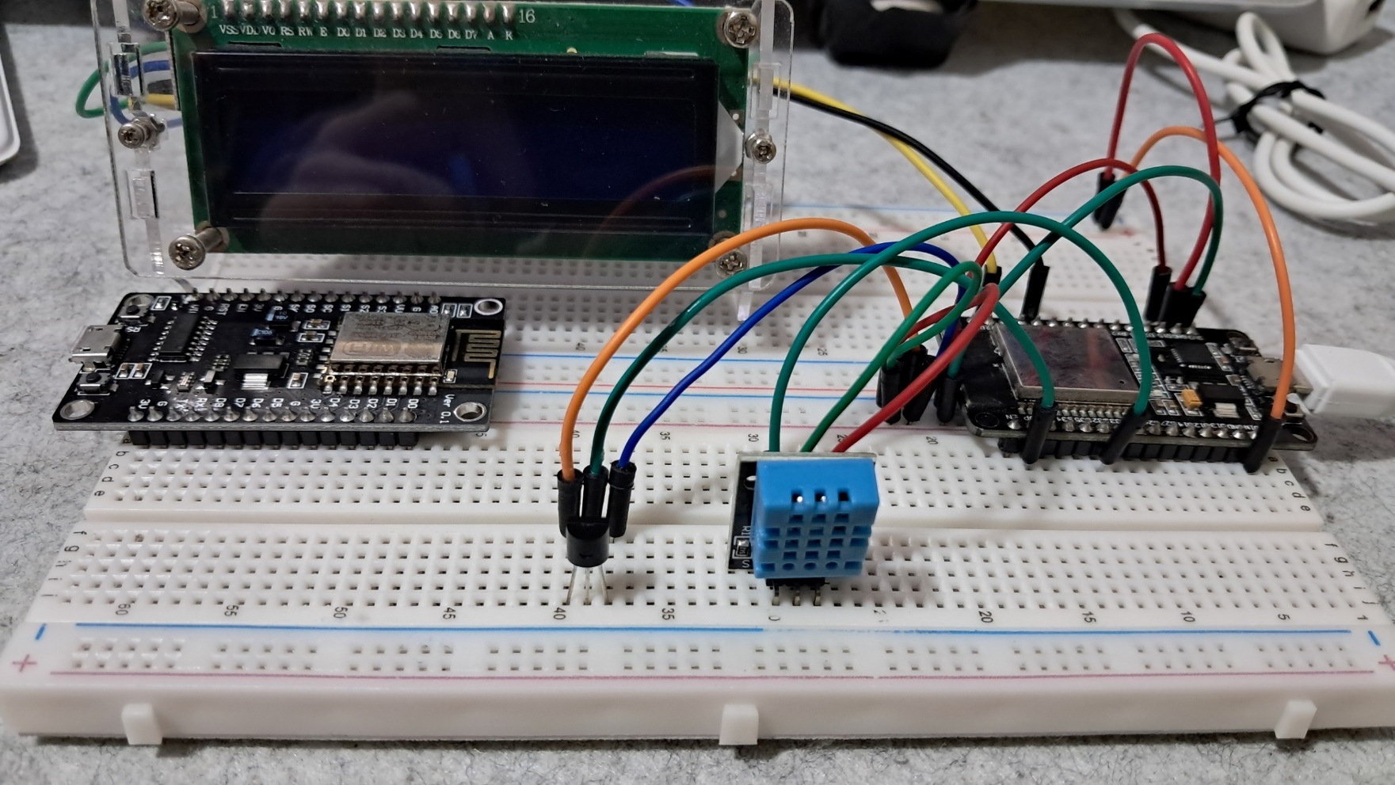
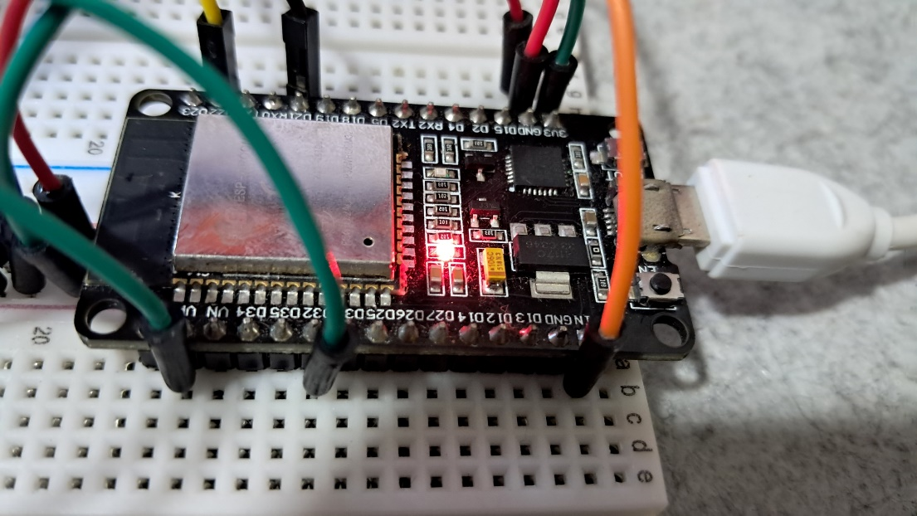
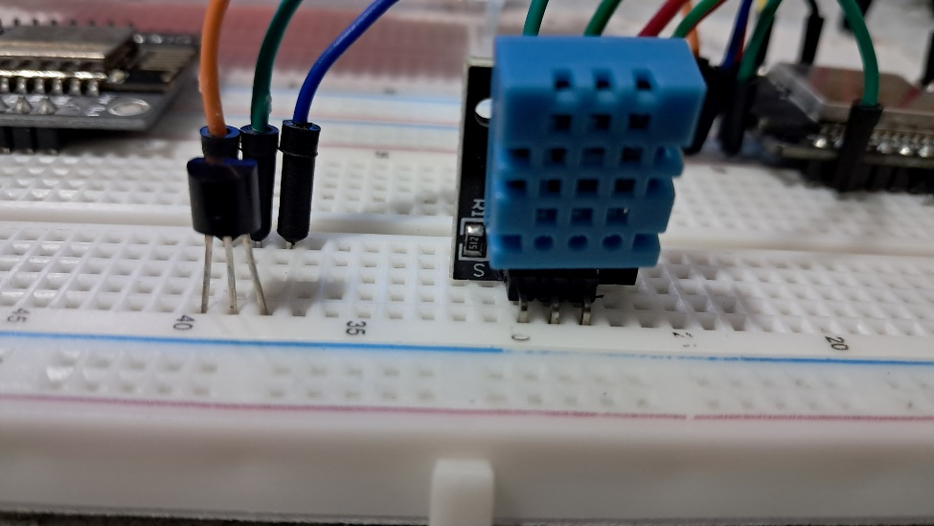
HARDWARE DISCUSSION

Slide 10
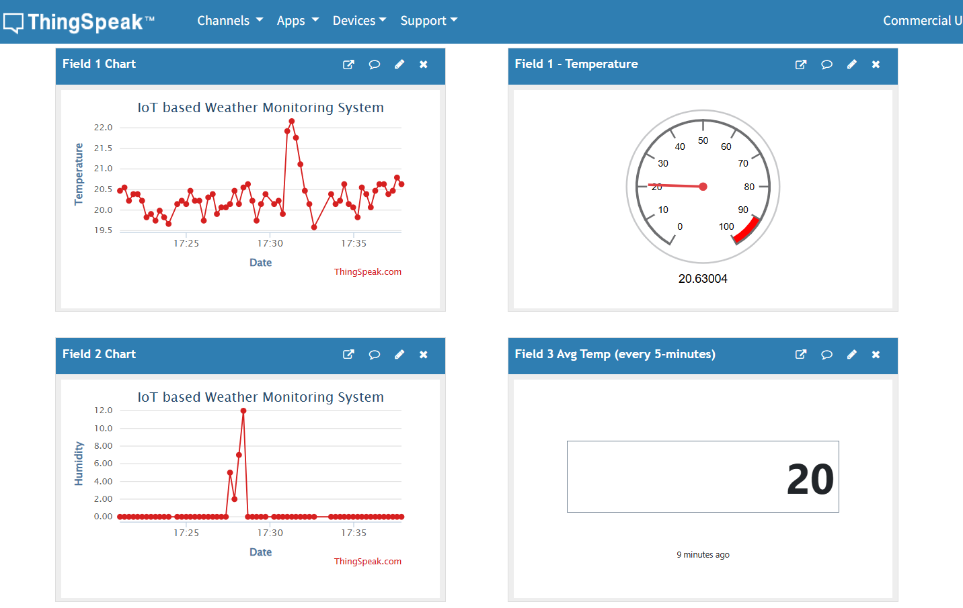
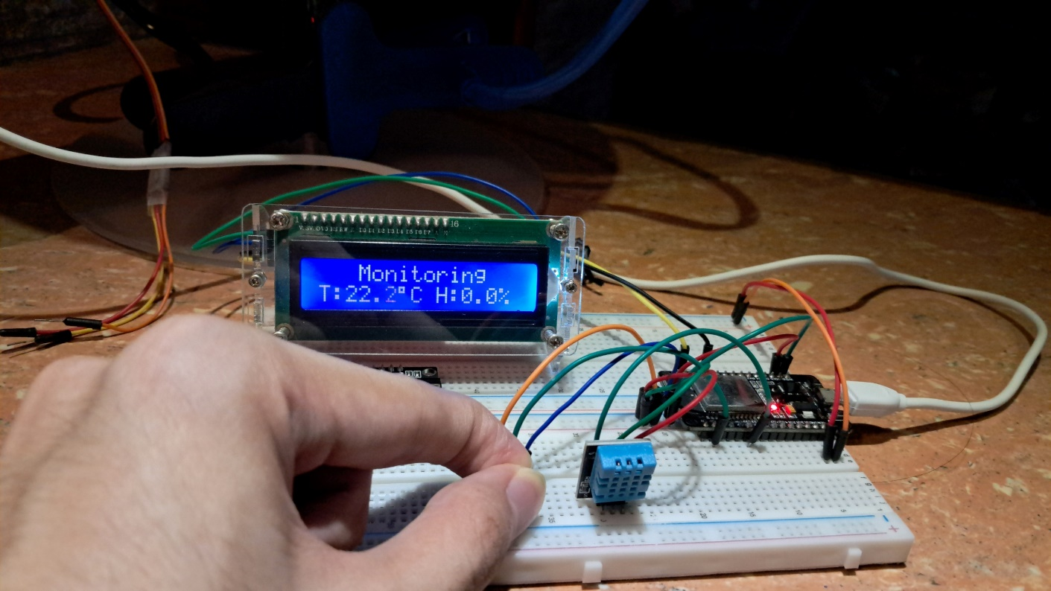
SAMPLE OUTPUT

Slide 11
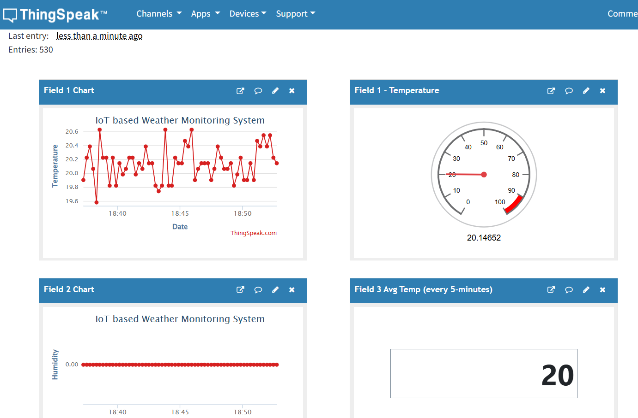
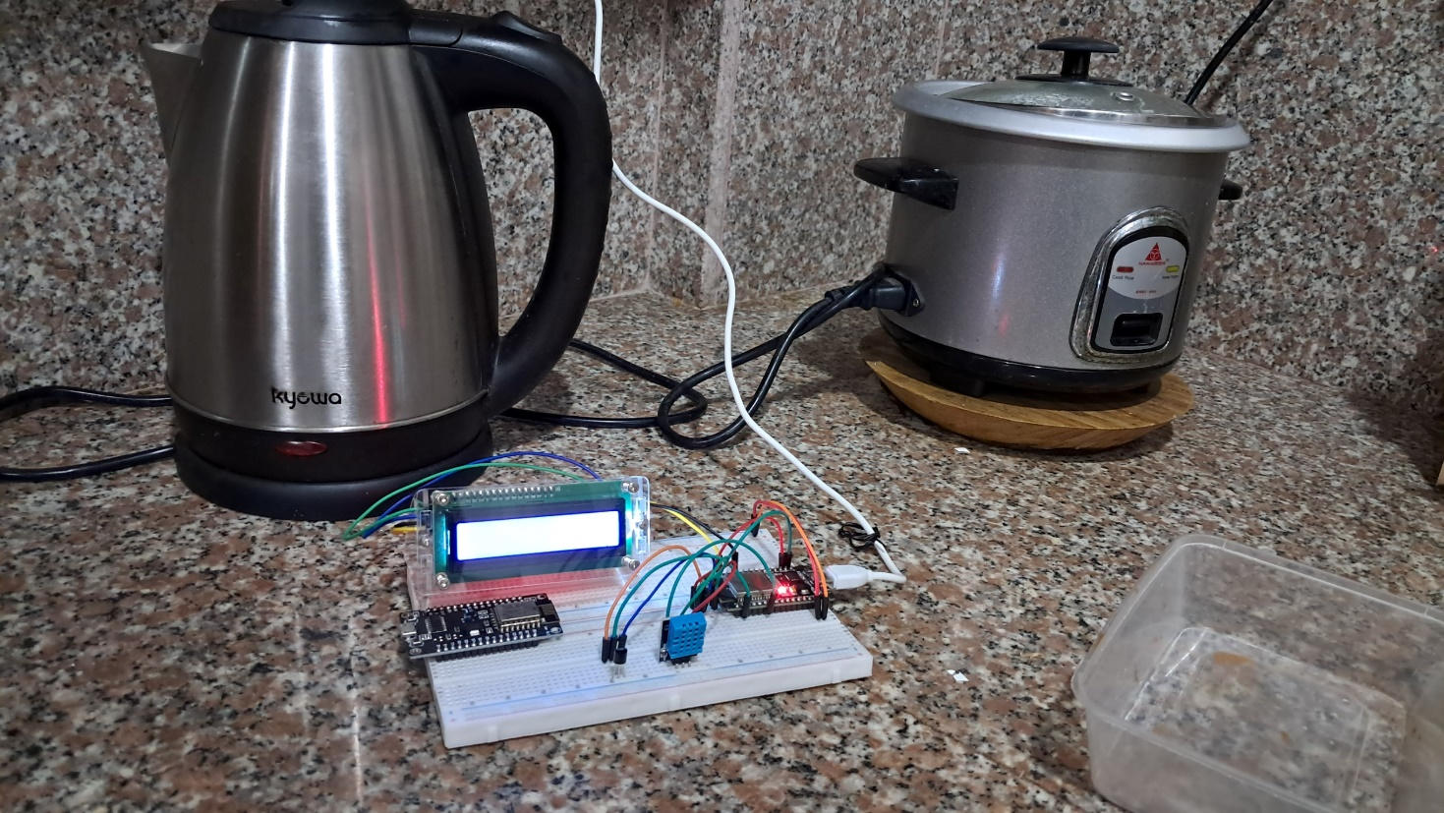
SAMPLE OUTPUT

Slide 12
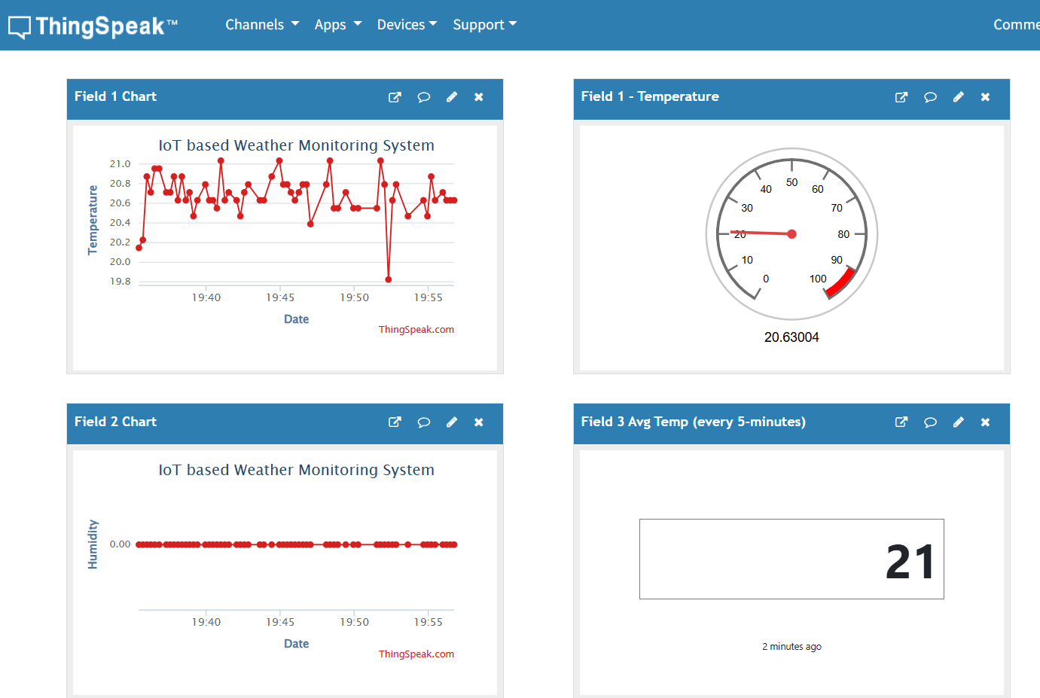
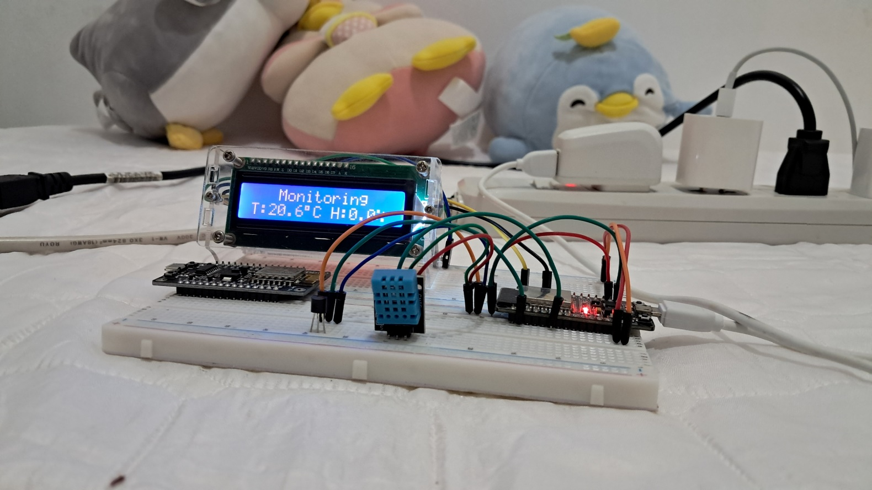
SAMPLE OUTPUT

Slide 13
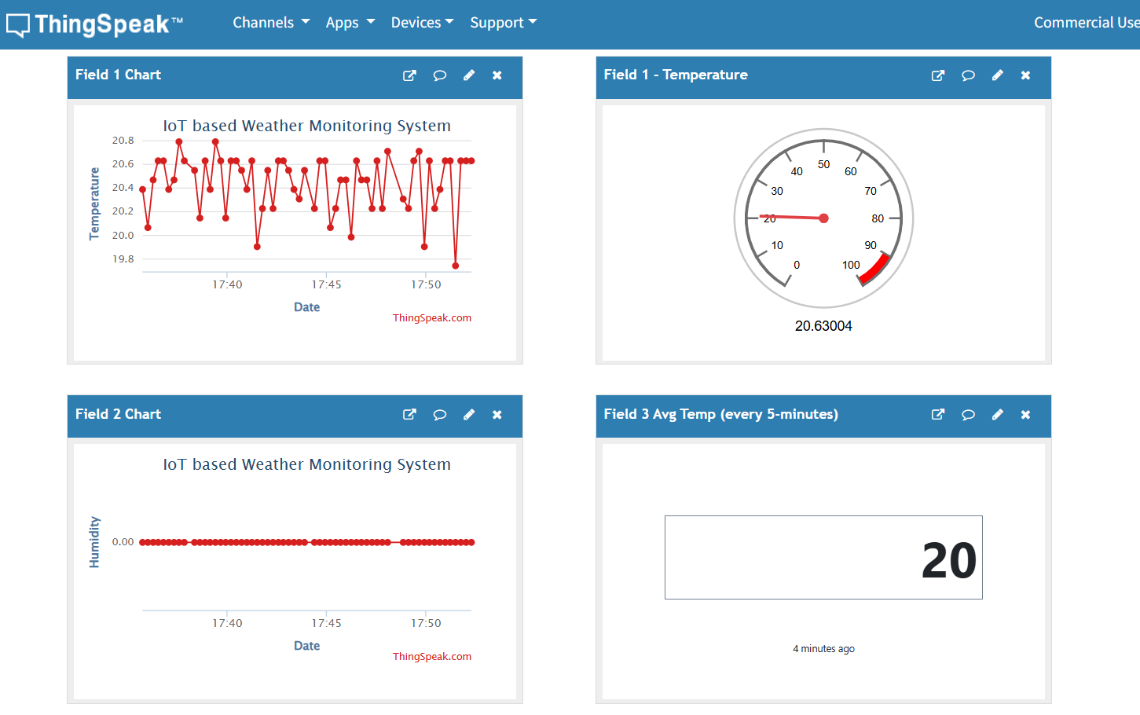
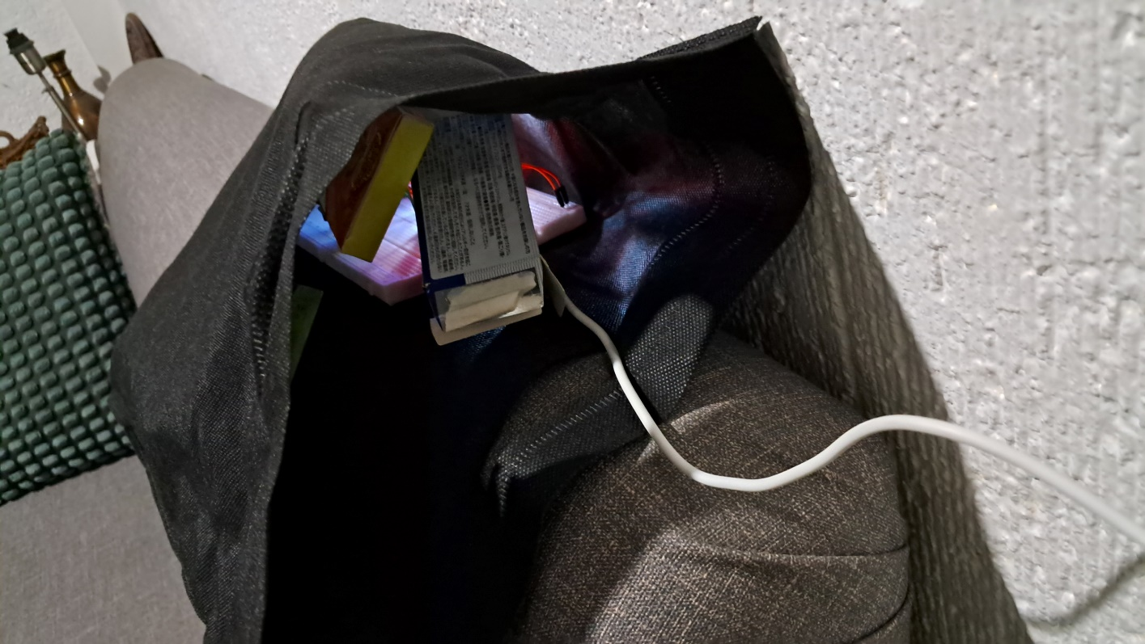
SAMPLE OUTPUT

Slide 14
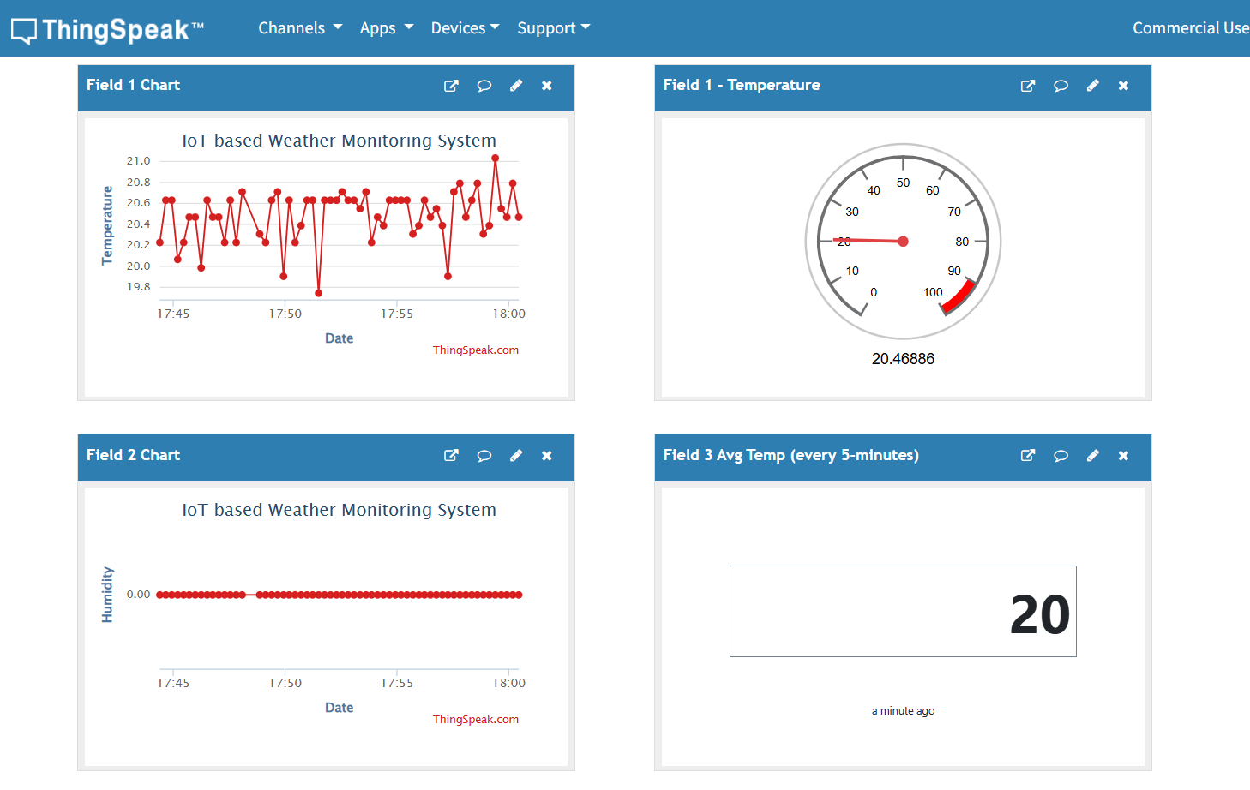
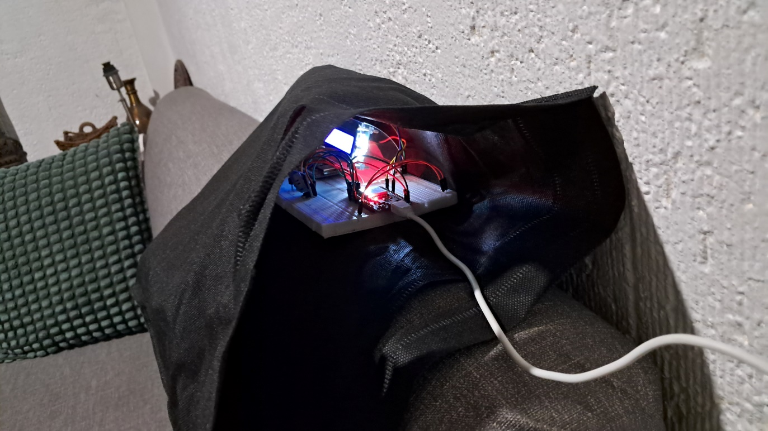
SAMPLE OUTPUT

Slide 15
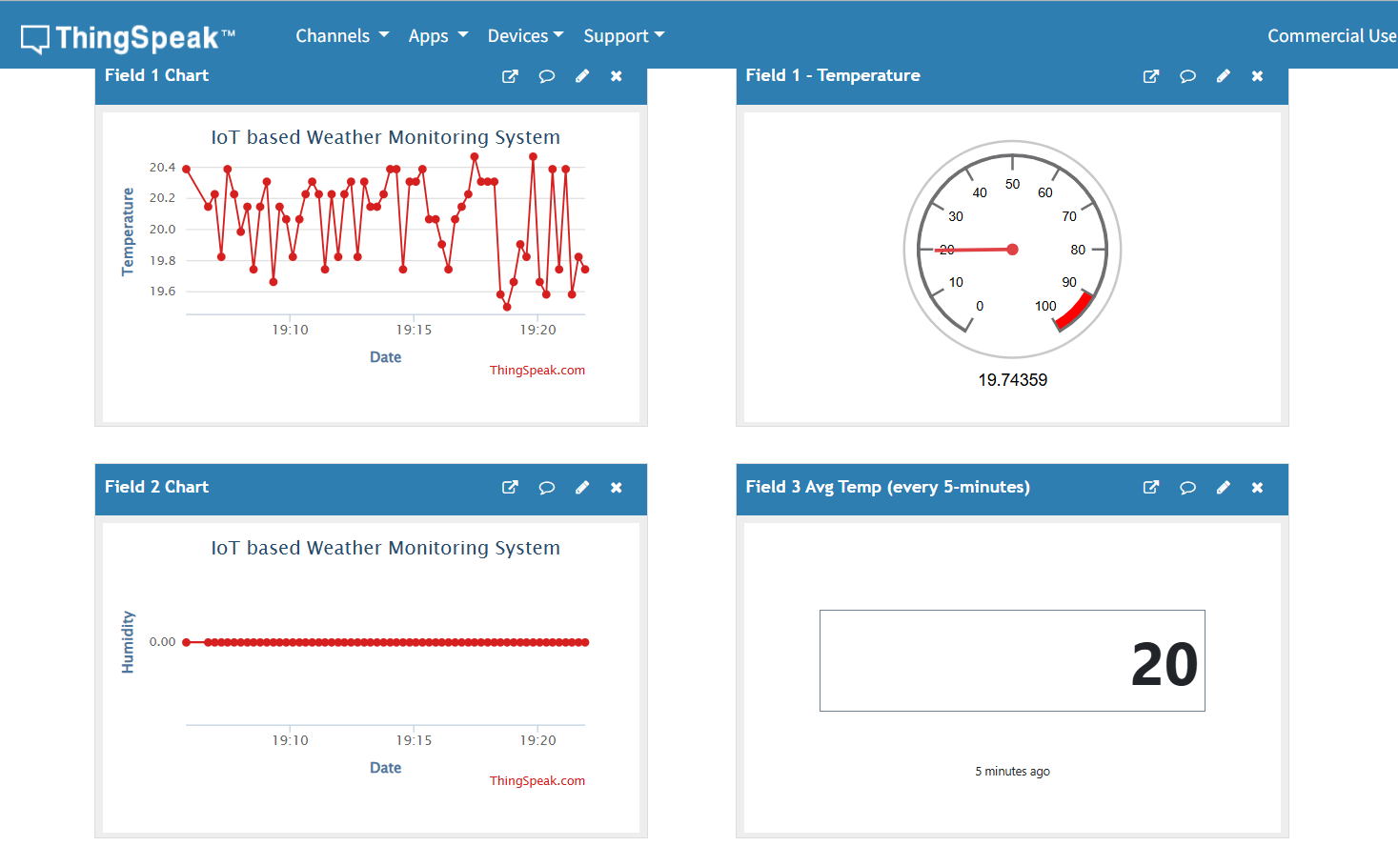
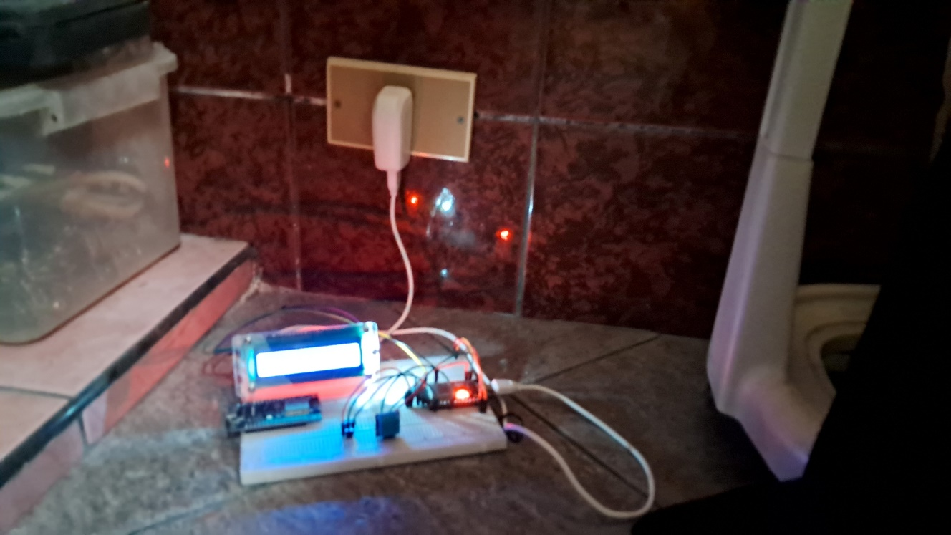
SAMPLE OUTPUT

Slide 16
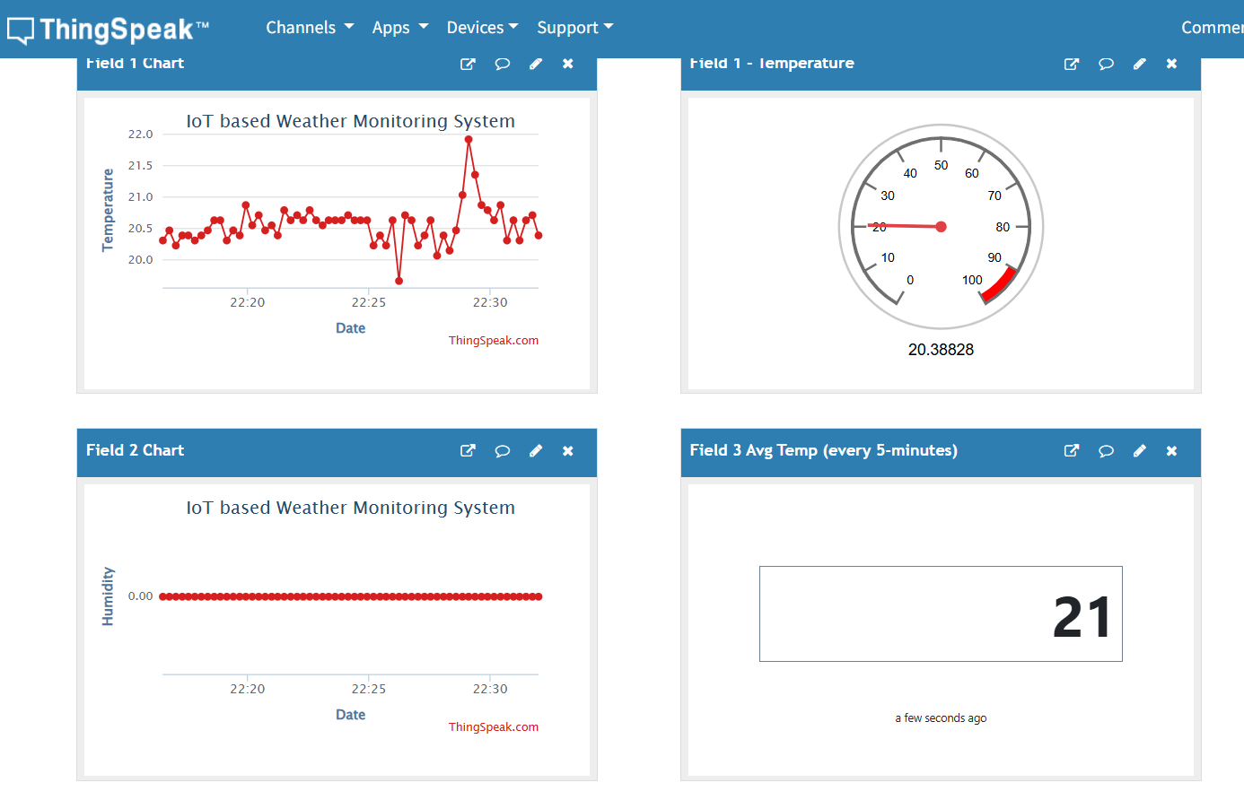
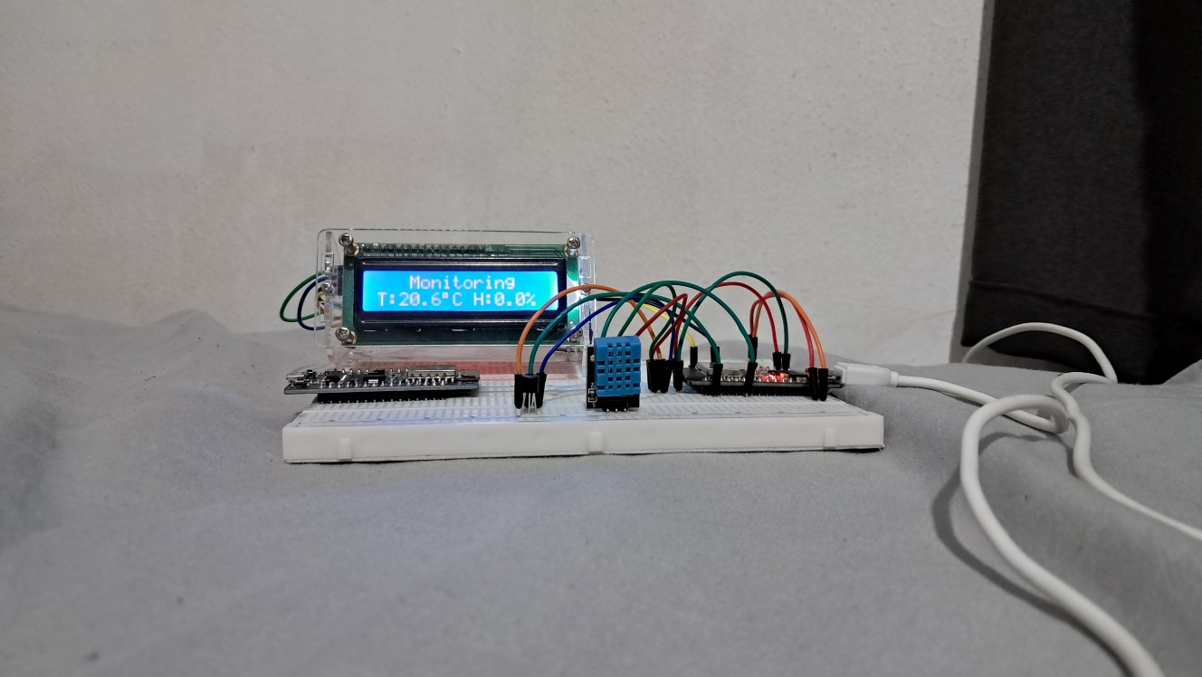
SAMPLE OUTPUT

Slide 17
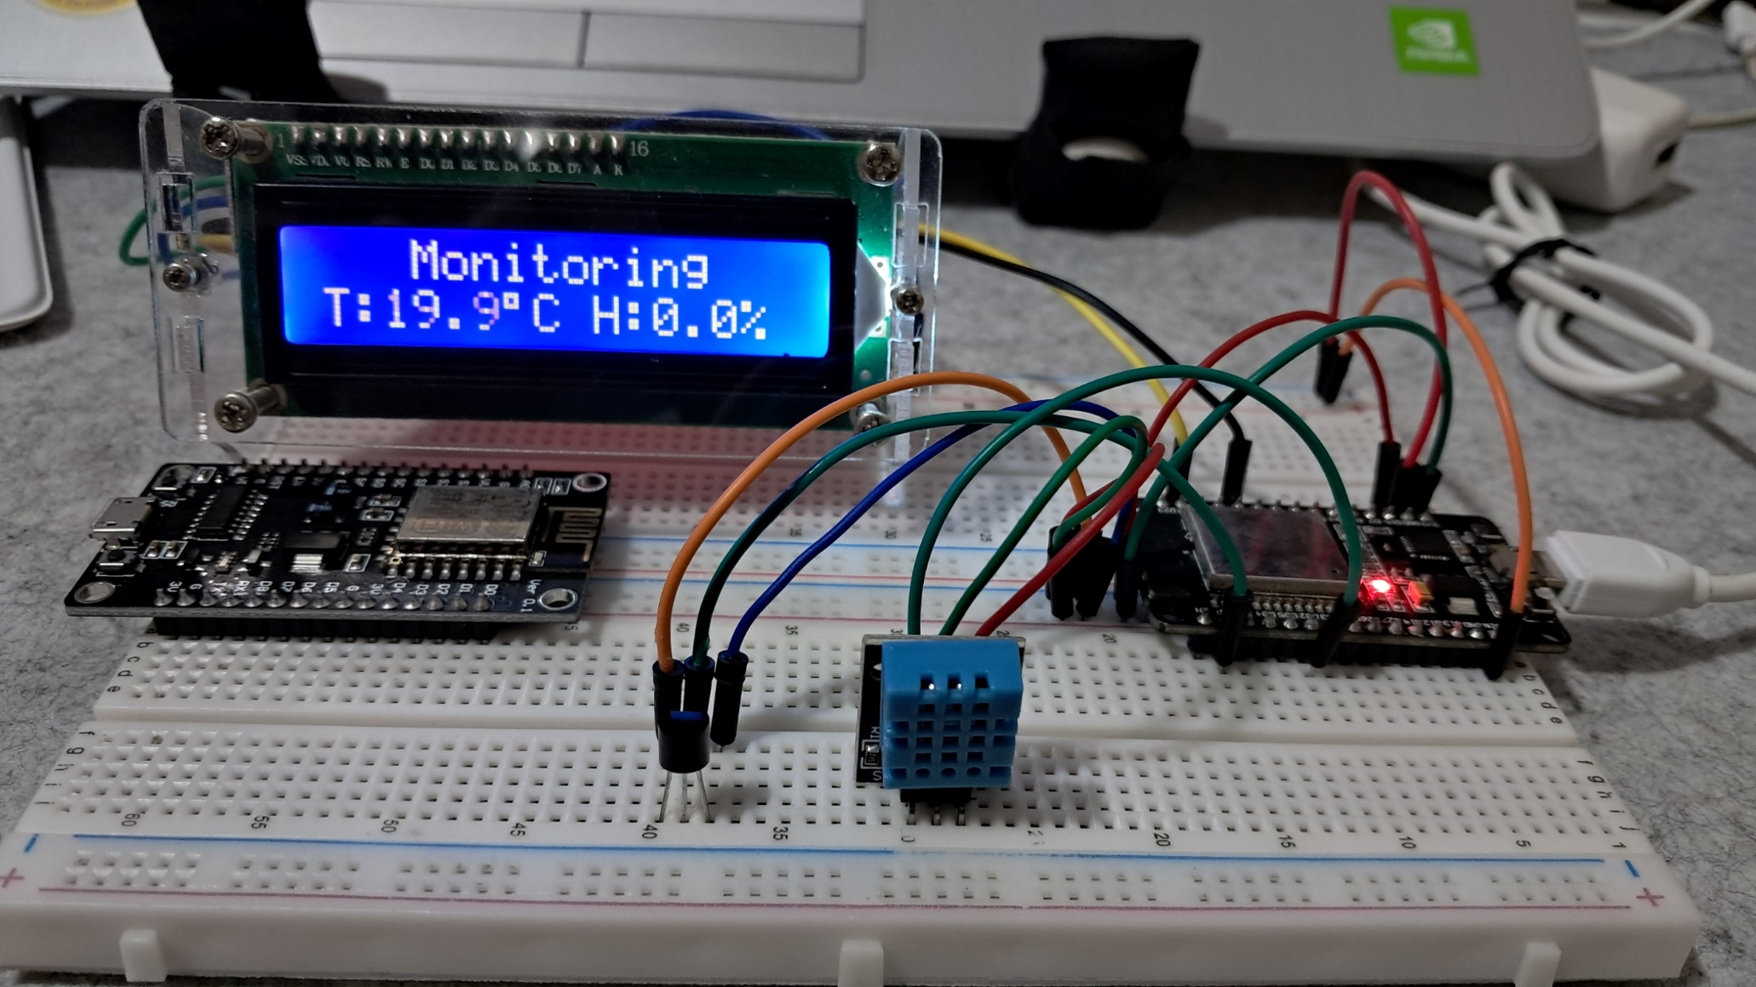
SAMPLE OUTPUT

Slide 18
DEMO VIDEO
Please click the YouTube link below for the video demonstration of EXP3:
https://youtu.be/1RSPqbIyssc?si=EOFiACpx5cHGnXzC

Slide 19
THANK YOU!

